Slide 1



C to ASM and ASM to C interface and coding guidelines (SHARC)
Presented by: Karthik.R
Date: 23-Mar-2011
Proprietary and Confidential

Slide 2
CONTENTS
WHY C
Registers and their types
Declaration in C and Asm
Naming Conventions
Function calls
Guidelines to be followed during Function calls
Argument Passing
Memory section definitions
Proprietary and Confidential

Slide 3
WHY C?
Why C for embedded applications ?
Advantages ????
Disadvantages ????
Proprietary and Confidential

Slide 4
WHY C?
Advantages:
Removes the problems of manual coding (Especially Errors)
Provides a level of Platform independence
Quick time to market
Ease of upgrade
Disadvantages:
Not as optimized as assembly implementation
Requires an amount of compiler knowledge (i.e. How the compiler translates / interprets the High level language code) to achieve a good level of optimization
Proprietary and Confidential

Slide 5
‘C’ Runtime Environment
Conventions to be followed:
Dedicated Registers
Usage of Preserved Registers
Scratch Registers
Stack Registers
Proprietary and Confidential

Slide 6
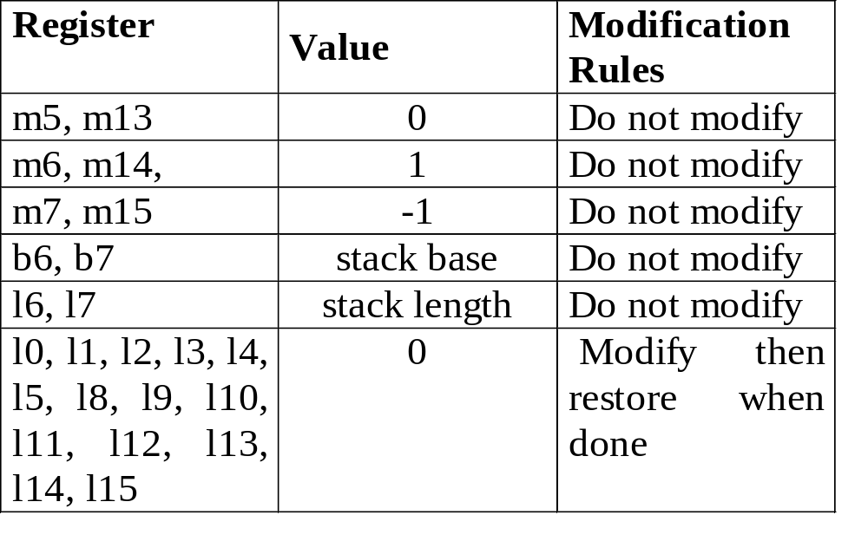
Dedicated Registers
Proprietary and Confidential

Slide 7
Preserved Registers
Assembly function must save the reserved registers during the start of function and restore the registers at the end of the function
Unaffected registers need not to be saved and restored
If a C function is called then no register saving is required as the C compiler will ensure that the environment is maintained.
Proprietary and Confidential

Slide 8
Reserved Registers
Base Registers:
b0, b1, b2, b3, b5, b8, b9, b10, b11, b14, b15,
Index Registers:
i0, i1, i2, i3, i5, i8, i9, i10, i11, i14, i15
mode1, mode2
Modifier Register:
m0, m1, m2, m3, m8, m9, m10, m11
Data Registers:
r3,r5, r6, r7, r9, r10, r11, r13, r14, r15
ustat1, ustat2
Proprietary and Confidential

Slide 9
Scratch Registers
A set of registers whose contents needn’t be saved and restored
The contents of these registers are not preserved across function calls.
Base Register
b4, b12, b13
Index Register and Modifier
i4, i12 , i13, m4, m12
Data Register
r0, r1, r2, r4, r8, r12
Proprietary and Confidential

Slide 10
Stack Registers
C run-time environment reserves a set of registers for controlling the run-time stack.
These registers should not be utilised and are classified as reserved
i7 Stack pointer
i6 Frame pointer
Activity: what is the difference between stack and frame pointer ?
Proprietary and Confidential

Slide 11
Declaration in C and ASM
The data type of the variable should be mentioned correctly while declaring any variable.
Eg: int example; unsigned int example.
Eg: In C In Asm
int test; .var temp;
int array[10]; .var buffer[10];
Question: How do you manage various formats (Int, Uint, float etc) in Asm ?
Proprietary and Confidential

Slide 12
Naming Conventions
Using C function or variable names in assembly routines and using assembly symbols in C code.
In asm code , to use a C symbol add an underscore prefix
Eg: Declaration in ASM → .var _temp;
Usage in C → extern int temp;
Eg: Declaration in C → int temp1;
Usage in ASM → .extern _temp1;
Proprietary and Confidential

Slide 13
Function Calling
While calling a function from C to assembly we need to prefix an underscore for use.
Also we must declare the function globally in asm.
While calling a function from assembly to C we need to use CCALL.
Eg: From C to ASM
In C In ASM
Test(); .global _Test; _Test:
Eg: From ASM to C
In ASM In C
ccall (_Test); Test() {
Proprietary and Confidential

Slide 14
Guidelines to be followed
Function call in C - subroutine in ASM
Include <asm_sprt.h> for Asm
Save and Unsave all the Registers in ASM function
Define them in code memory segment
Declare the function as global
Use entry and exit at the beginning and end of the function to return.
Function call in ASM - subroutine in C
Use ‘_’ prefix for the function name and ccall for calling
Note: In C, function can be used without any prefix in Function name
Function call in ASM - subroutine in ASM
Declare the function as global
Terminate the function with rts (Return to Subroutine)
Proprietary and Confidential

Slide 15
Argument Passing
C run-time environment uses a set of registers and the run-timestack to transfer function parameters to assembly routines
r4 receives the first argument
r8 receives second argument
r12 receives third argument
Remaining parameters of the argument are being passed to stack. They can be retrieved using “reads(n)” instruction
r0 has the return value of the function
Eg : Test(int a , int b , float c , float d)
Proprietary and Confidential

Slide 16
Argument Passing
Eg: Function calling from C
Int Add(int a, int b) /* Declaration */
c = Add(a,b); /* Function Call */
Function in asm
_Add:
entry;
r0 = r4 + r8;
exit;
Here r4 contain the value of ‘a’, r8 contain value of ‘b’, and the sum is returned through r0.
Proprietary and Confidential

Slide 17
Argument Passing
Eg: Function calling from Asm
r4 = 10;
r8 = 12;
ccall(_Myfunc);
dm(result) =r0;
Function in C
        int Myfunc(int n, int m)
        {
        int z;
        z = m + n;
        return z;
        }
Proprietary and Confidential

Slide 18
Section Definitions
Required sections in LDF:
Seg_pmda :
Program memory data section, declared as 32 bit wide memory
Seg_pmco :
Program memory code section, declared as 48 bit wide memory
Seg_dmda :
Data memory section name, declared as 32 bit wide memory
Seg_stak :
C-Runtime Stack section declaration
Seg_heap :
C-Heap section declaration
Proprietary and Confidential

Slide 19
QUESTIONS?
Proprietary and Confidential

Slide 20
Time for some Hands-on
Write example codes for the following
C to asm calling
Asm to C call
Asm to Asm call
All in one program can be attempted
Proprietary and Confidential

